Slide 1

AI Fitness Plan Generator: Revolutionizing Wellness
Welcome! Today, we're excited to introduce an innovative AI-powered platform for personalized fitness plans.
Presented by:
2022CS92 Misbah Sultan
2022CS62 Aqsa Batool

Slide 2

Introduction
The AI Fitness Plan Generator is a smart system designed to provide personalized diet and workout plans based on user inputs. By collecting details such as age, weight, height, food preferences, health conditions, and allergies, the system generates tailored recommendations that align with individual fitness goals.
This project aims to save time and effort while delivering effective, user-specific solutions to promote overall well-being.

Slide 3
Project Overview:
AI-Powered Wellness
Personalized Plans
Diet and workout plans tailored to individual needs.
AI-Driven Recommendations
Leveraging user input for optimal results.

Slide 4

Key Features: Simplifying Fitness
1
Comprehensive Input
2
Personalized Recommendations
Collecting detailed information for accurate plans.
Tailored diet and workout plans for each user.
3
Location-Based Guidance
Restaurant suggestions for healthy eating options.

Slide 5
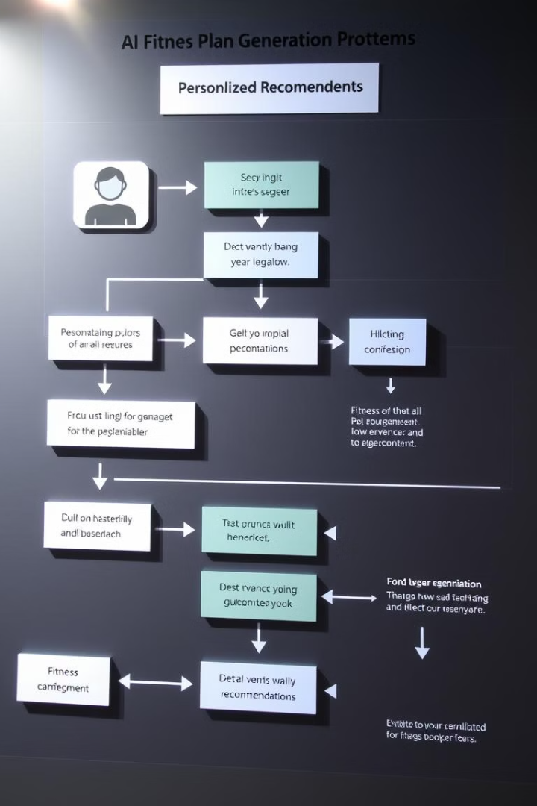
How It Works: AI-Powered Process
1
User Input
Collecting personal details and fitness goals.
2
AI Processing
Analyzing user data and generating tailored plans.
3
Output Generation
Providing personalized diet and workout recommendations.

Slide 6
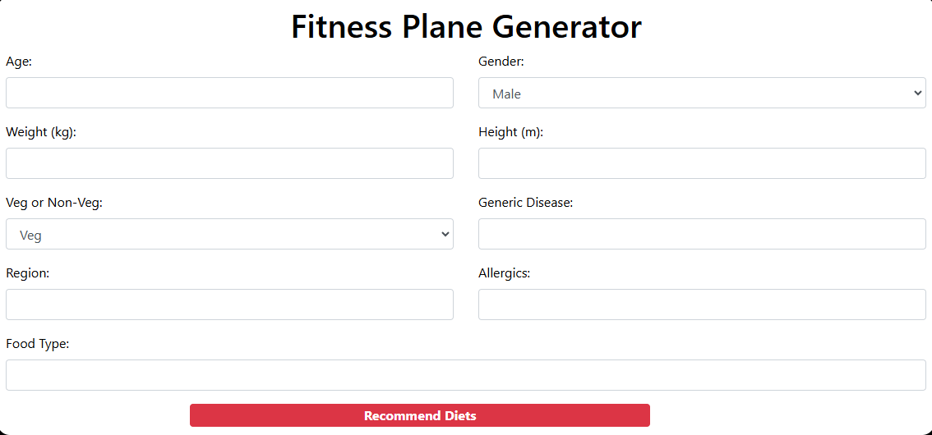
User Input Interface: Gathering Data
Our user-friendly input form gathers essential information, ensuring personalized plans.

Slide 7

Output - Diet Recommendations: Healthy Choices
Region-Specific Restaurants
Breakfast Ideas

Slide 8


Output - Dinner & Workout Plans: Balanced Lifestyle
Dinner Options
Workout Plans

Slide 9




Technology Stack: Building the Platform
Frontend
HTML, CSS for a user-friendly interface.
Backend
Python with AI libraries for processing and analysis.
Deployment
Local or web-based system for accessibility.

Slide 10





Benefits: A Holistic Approach
Personalized Plans
Catering to individual needs and goals.
Easy to Use
Simple input and easy-to-understand outputs.
Time-Saving
Instant recommendations for efficient planning.
Health-Focused
Encouraging balanced nutrition and active lifestyles.

Slide 11

Conclusion: Shaping a Healthier Future
The AI Fitness Plan Generator empowers individuals to take control of their wellness.

